Slide 1
RABIES VIRUS
Family RHABDOVIRIDAE

Slide 2
Morphology
Bullet shaped, with one end round and other planar or concave
Nucleocapsid shows helical symmetry containing a single stranded RNA genome and an RNA dependent RNA polymerase

Slide 3
The outer lipoprotein envelop contains haemagglutinating peplomer spikes which does not cover the planar end
Below the lipoprotein envelop is the matrix protein layer

Slide 5
Resistance
It is highly resistant
It is sensitive to lipid solvents such as chloroform
It is inactivated by phenol, formalin and heat

Slide 6
Pathogenesis
It is a natural infection of dog, fox, cat, bat
Man is infected by the bite of rabid dog
Saliva containing virus is deposited in the wound

Slide 7
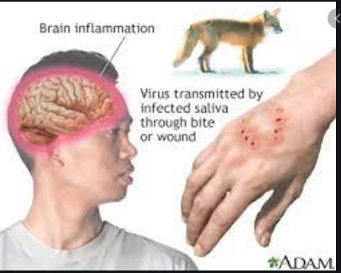
The rabies virus multiplies in the muscle or connective tissue at or near the site.
Then it spreads through the peripheral nerves to the CNS
From CNS it spreads to the peripheral nerves and involves skeletal and myocardial muscles, adrenal gland and skin

Slide 9
Laboratory diagnosis
Diagnosis in human
Diagnosis in animal

Slide 10
Diagnosis in human
Immunofluorescence test: virus can be detected in the saliva by direct Immunofluorescence using antirabies serum tagged with fluorescent dye.

Slide 11
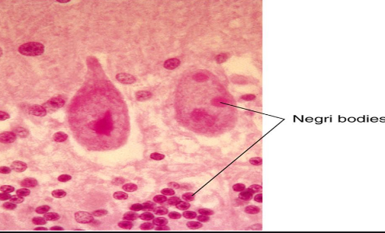
Negri bodies
Demonstration of negri bodies: it is demonstrated in brain. Negribodies appears as intracytoplasmic, oval or round, purplish pink body with characteristic basophilic inner granules.

Slide 12
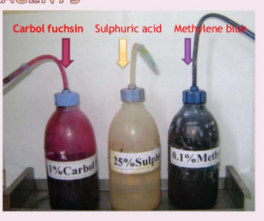
Seller’s technique
Seller’s technique: basic fuchsin and methylene blue in alcohol is used to demonstrate these bodies.

Slide 13
Virus isolation: the virus can be isolated from CSF, saliva and urine by intracerebral inoculation in mice.
Inoculated mice is examined for signs of illness and their brain is examined at death for negri bodies

Slide 14
Diagnosis in animal
Specimen used: brain of the rabid animal
Immunofluorescence test: it is done in brain tissues to detect viral antigen

Slide 15
Diagnosis in animal
Demonstration of negri bodies: smears of brain are stained with seller’s technique and examined for negri bodies
Virus isolation: the brain tissue suspension is injected intracerebrally into mice. They die within 3 weeks showing negri bodies in brain.

Slide 16
Other tests
Neutralization test
CFT
Counter immunoelectrophoresis
ELISA

Slide 17
PROPHYLAXIS
1. pre exposure prophylaxis: done in laboratory personnel and those who handle infected animals
2. Post exposure prophylaxis: local treatment, hyperimmune serum and vaccination

Slide 18
Local treatment
Wash the wound with soap and water for 15 minutes.
Then the wound is treated with alcohol, tincture iodine or ammonium compound
In severe cases, antirabic hyperimmune serum can be applied

Slide 19
Damaged tissue is excised but wound is left unsutured
Anti tetanus vaccine and antibiotics are administered
Watch the animal for 10 days
If animal is healthy, rabies may be excluded

Slide 20
Hyper-immune serum
Human antirabies immunoglobulin 20 IU / kg
Half infiltrated locally
Half administered IM

Slide 21
VACCINATION
TYPES
Neural
Non neural
Subunits

Slide 22
Neural vaccines
Semple vaccine
Beta propiolactone
Infant brain vaccine

Slide 23
Non neural vaccines
Egg vaccine
Cell culture vaccine

Slide 24
Vaccination schedule
Neural vaccine: subcutaneously on anterior abdominal wall
Cell culture vaccine

Slide 25
Pre exposure vaccination
3 doses
1 ml on day 0,7,21 -→IM
BOOSTER DOSE after one year
Then one every 5 years

Slide 26
Post exposure vaccination
1 ml IM in deltoid region
On day 0, 3, 7, 14 & 30
Booster dose on day 90
This gives protection for five years
In children the site is anterolateral aspect of the thigh

Slide 27
Animal vaccination
Single dose
1 ml IM
BOOSTER DOSE at 1-3 year intervals

Slide 28
Treatment
Intensive supportive care
Hyper immune serum administration

Slide 29
Prevention
Elimination of stray dogs
Vaccination of pets
Control measures on wild life
HE

